Slide 1

Activity: Magic QR Code
In this activity, you will:
Interact with QR codes that perform unexpected actions (e.g., opening URLs, sending emails).
Learn how attackers use QR codes for phishing or malware distribution.
Discuss how to verify the safety of QR codes before scanning.

Slide 2
Magic QR Code
Scan the QR codes and note what happens.
Some codes will open safe websites.
Others will display unexpected messages or pre-written emails.
Watch out for fake phishing message(s) or a malicious QR code.

Slide 3
Extension Task:
Create your own QR Code
Verification Tools
Check the link first
Norton Snap
Kaspersky QR Scanner
Notes:
Time: about 10 minutes

Slide 4
Reflection and Discussion
Questions to Discuss
What makes QR codes risky?
How can attackers use QR codes for phishing or malware distribution?
What steps can you take to ensure QR codes are safe before scanning?
Key Takeaways
Always verify QR codes before scanning, especially in public spaces.
Avoid scanning QR codes that look suspicious or come from untrusted sources.
Use mobile security software that warns against malicious links.
Notes:
Time: about 10 minutes

Slide 5
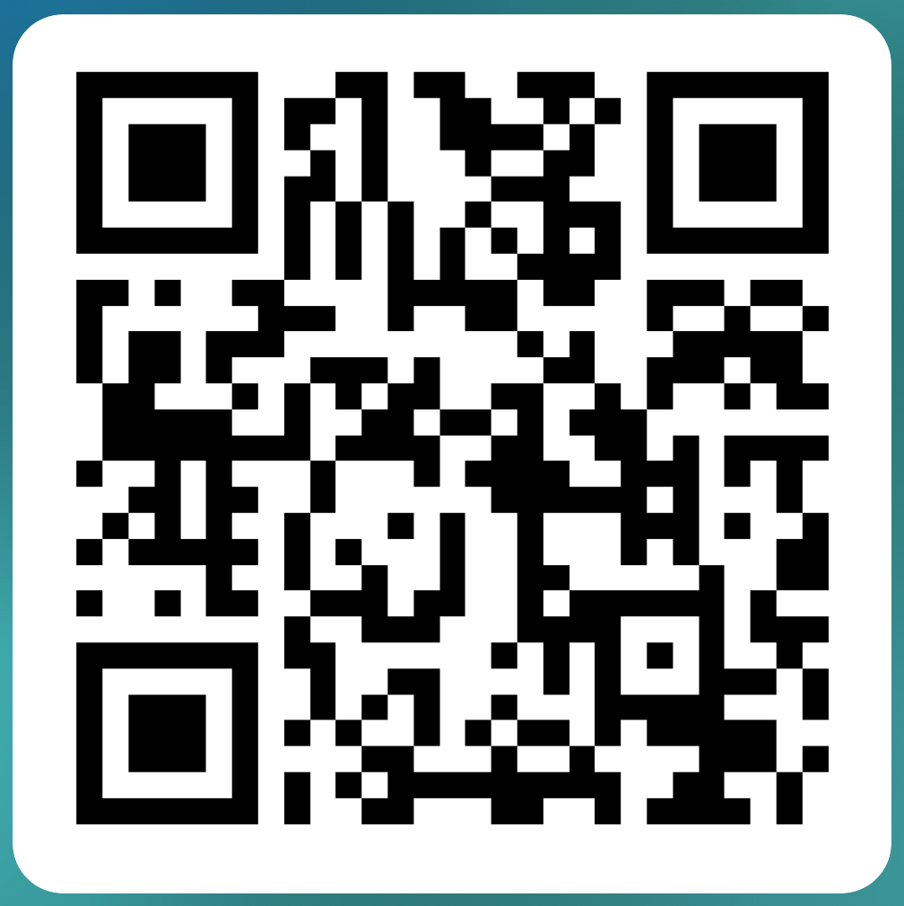
Any question?
Please participate in a quick survey
bit.ly/csltueventsurvey
(5 min)

